Slide 1
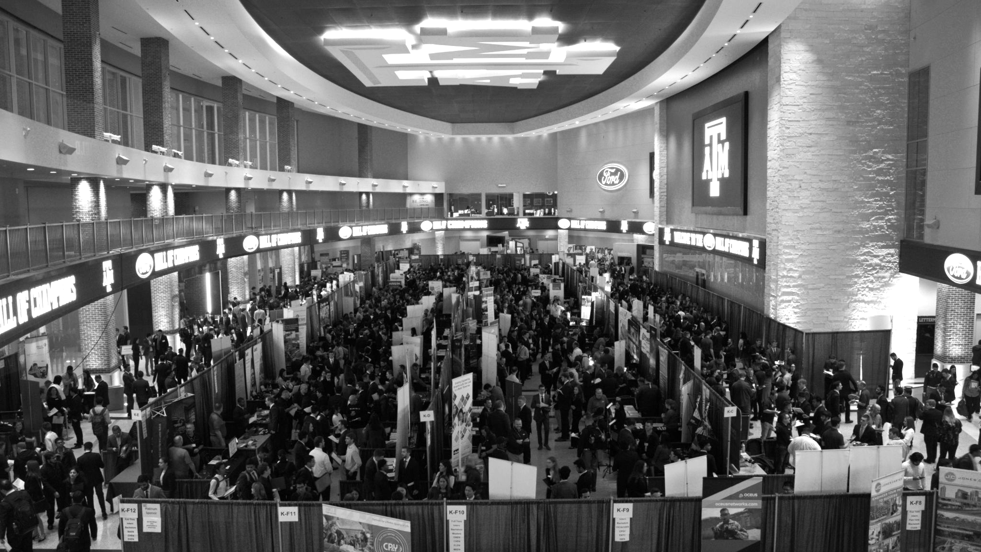

LANL Team Update
01/31/2025
Izzy Baumler, Dalton Boeckmann, Morgan Gullo, Jade Waldron

Slide 2
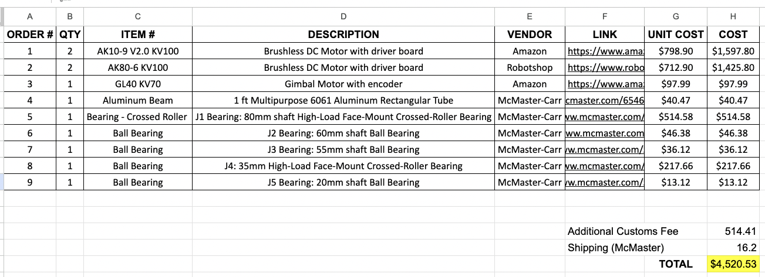
Updated BOM

Slide 3
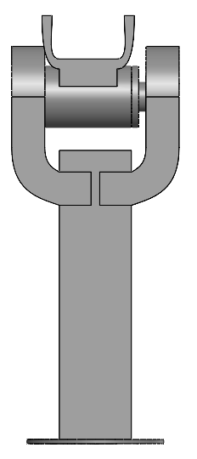
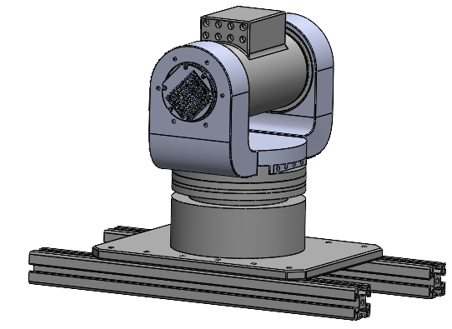
3DOF Vision

Slide 4
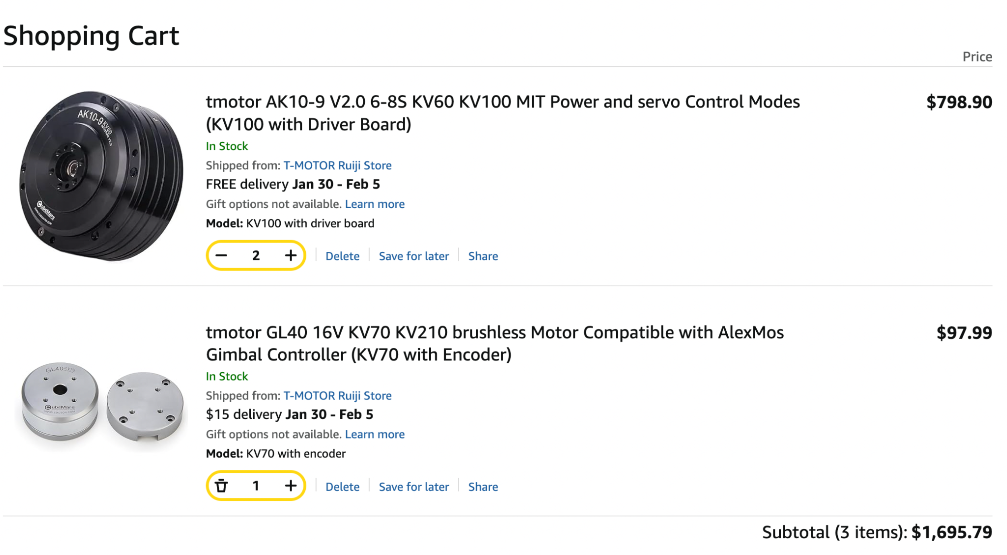
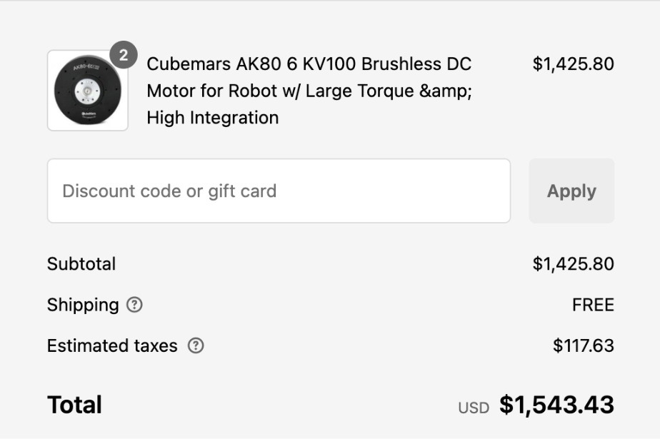
Orders Purchased
Delivered and Picked up
Canceled Order

Slide 5
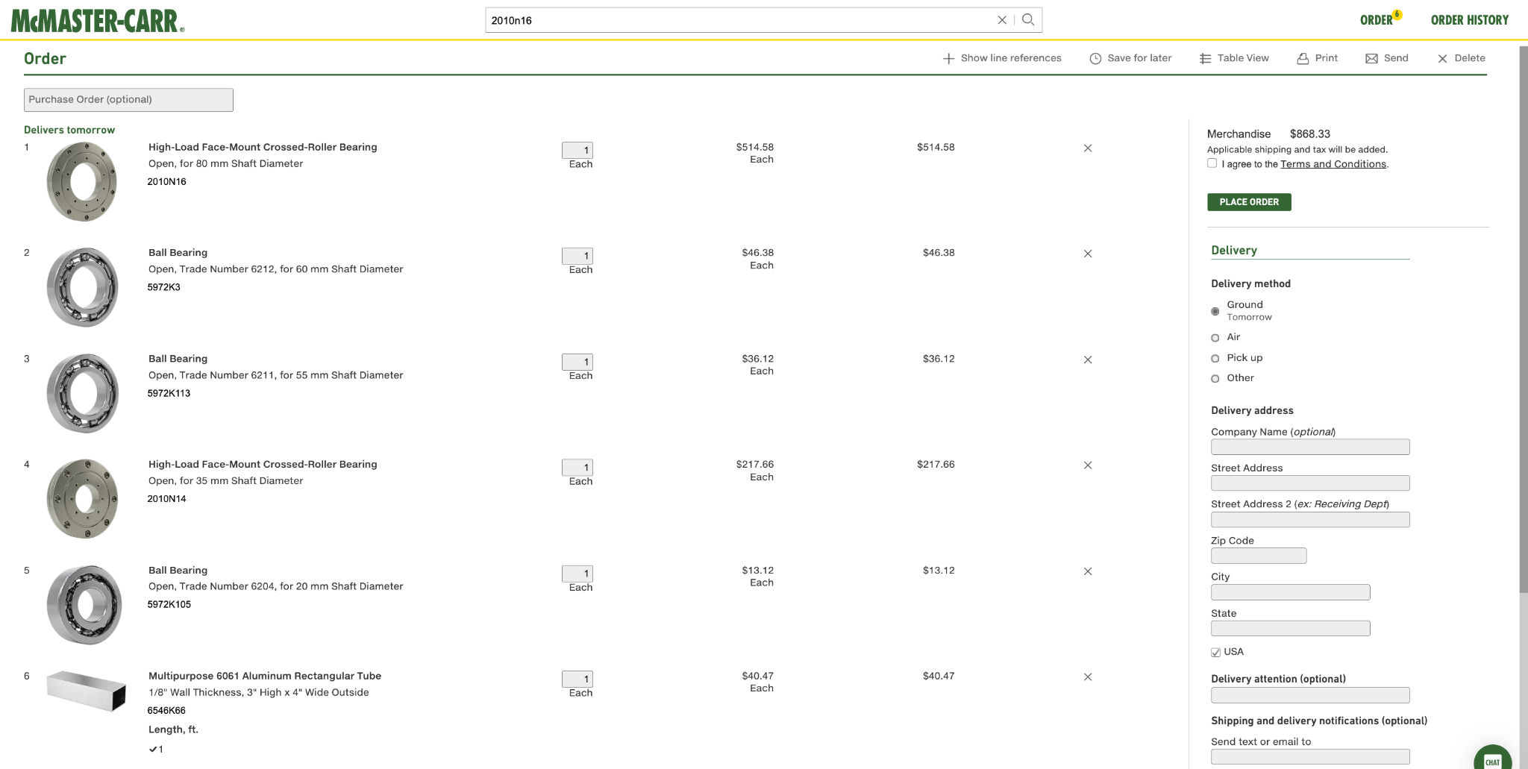
Orders Purchased
Delivered and Picked up

Slide 6
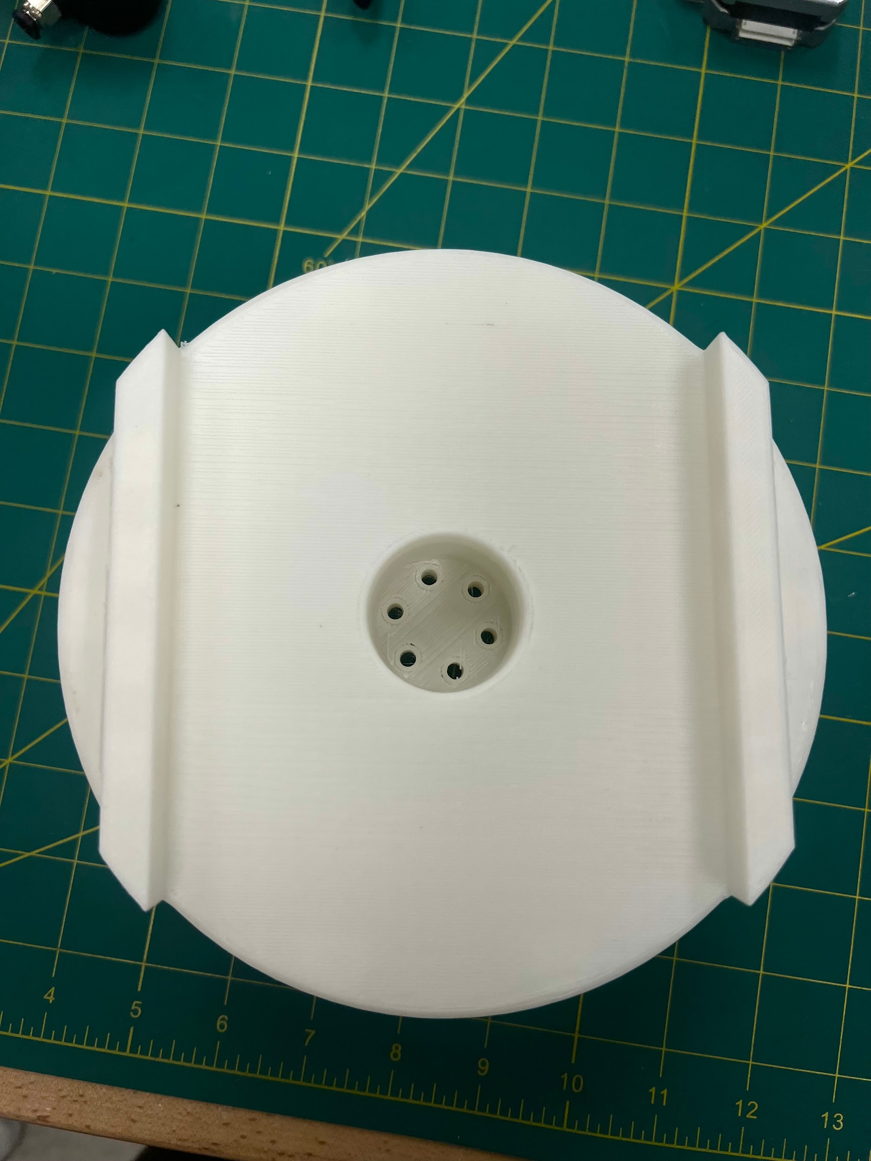
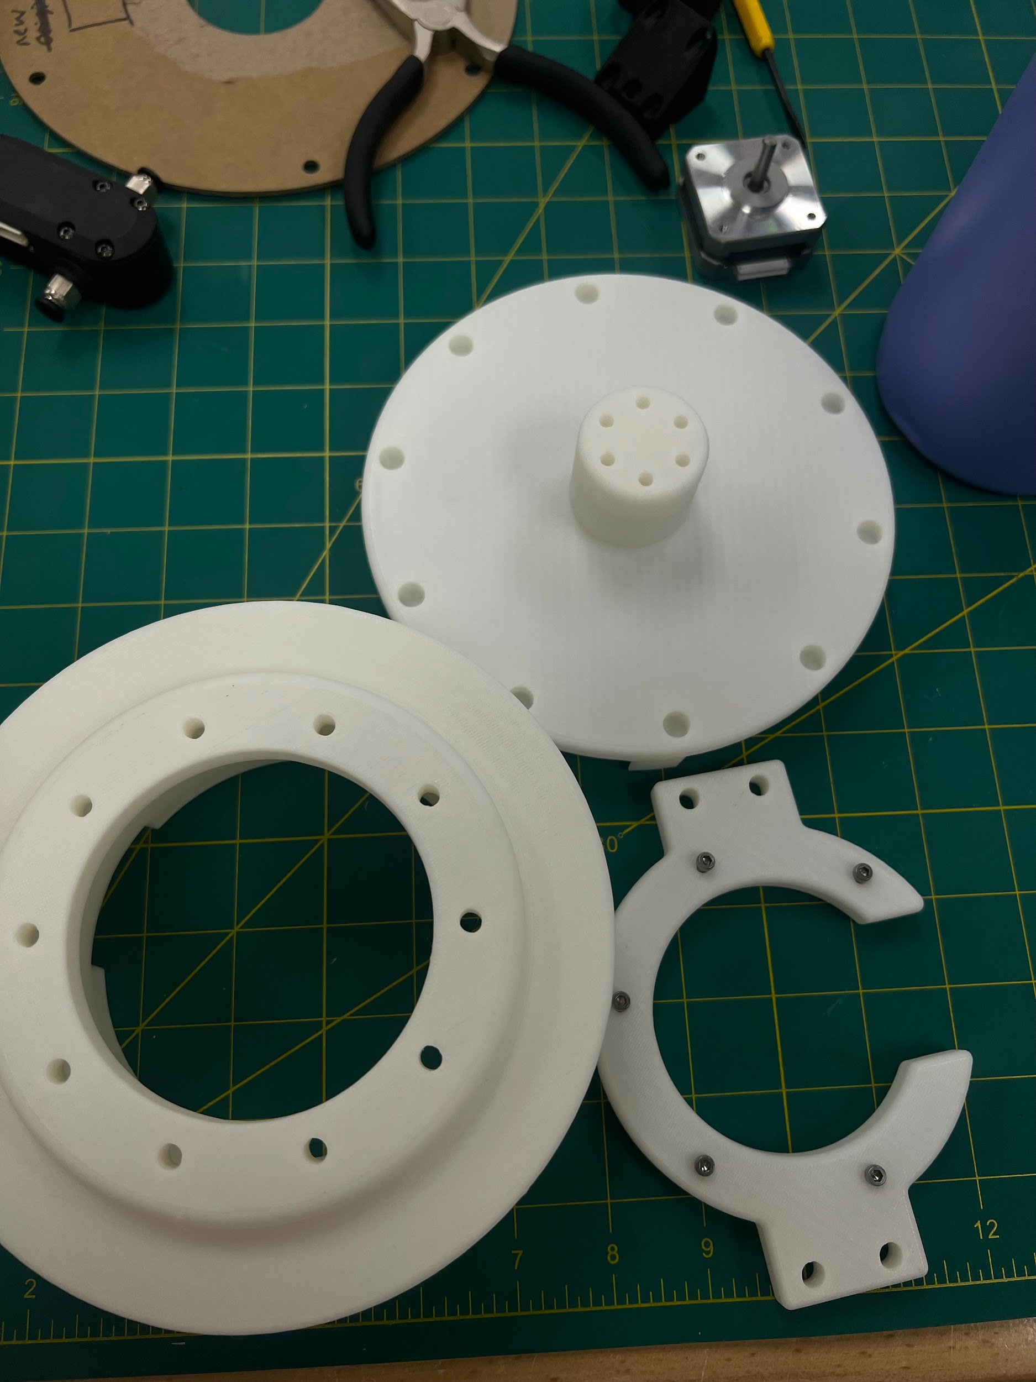
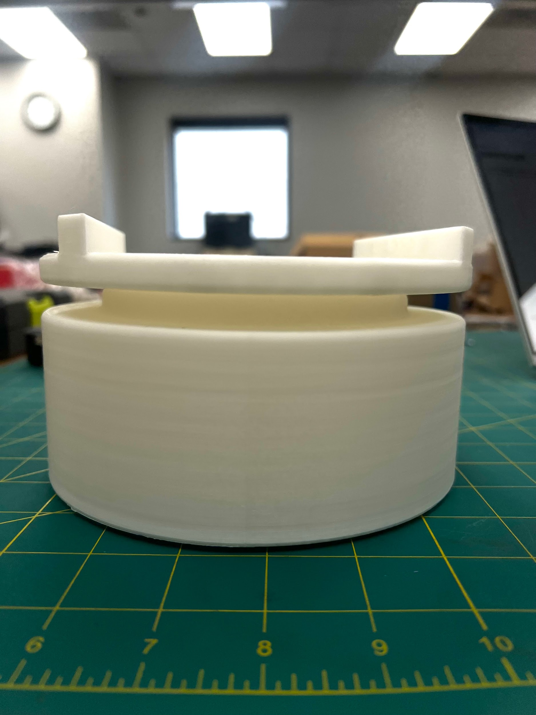
PLA Prints
Printed through RPS
PLA with 15% infill density
Grid infill pattern
Holes were not as accurate as expected
will be increasing size of them to accommodate

Slide 7
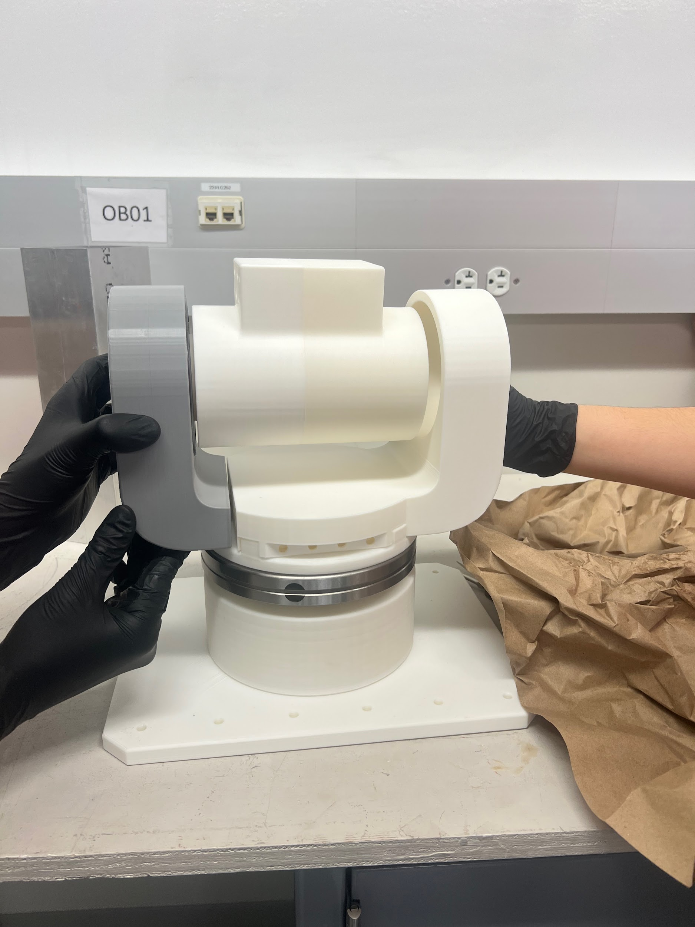
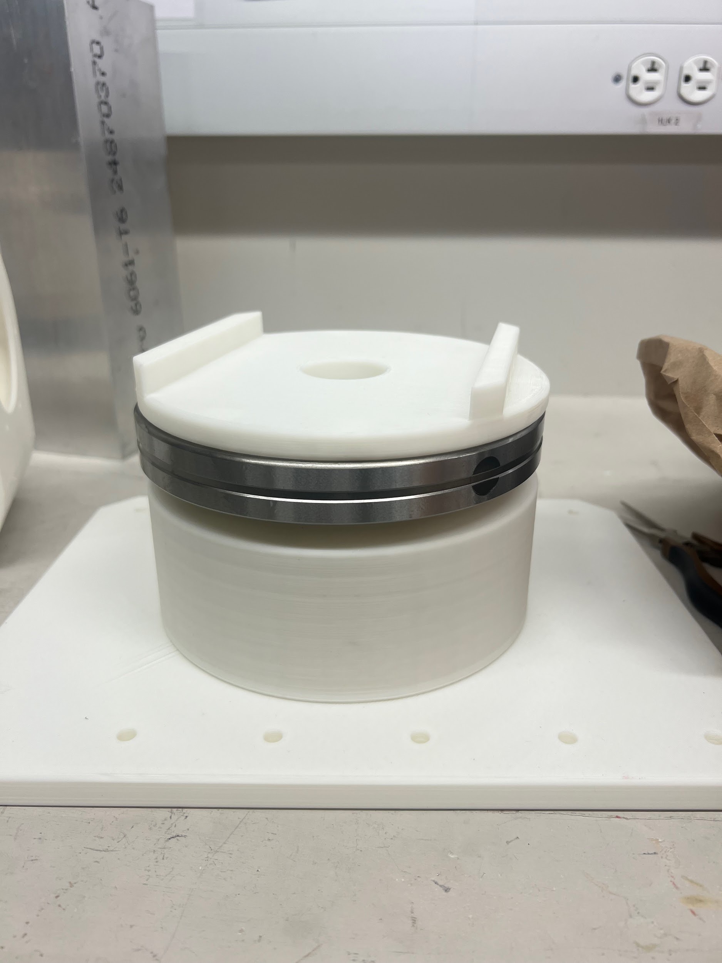
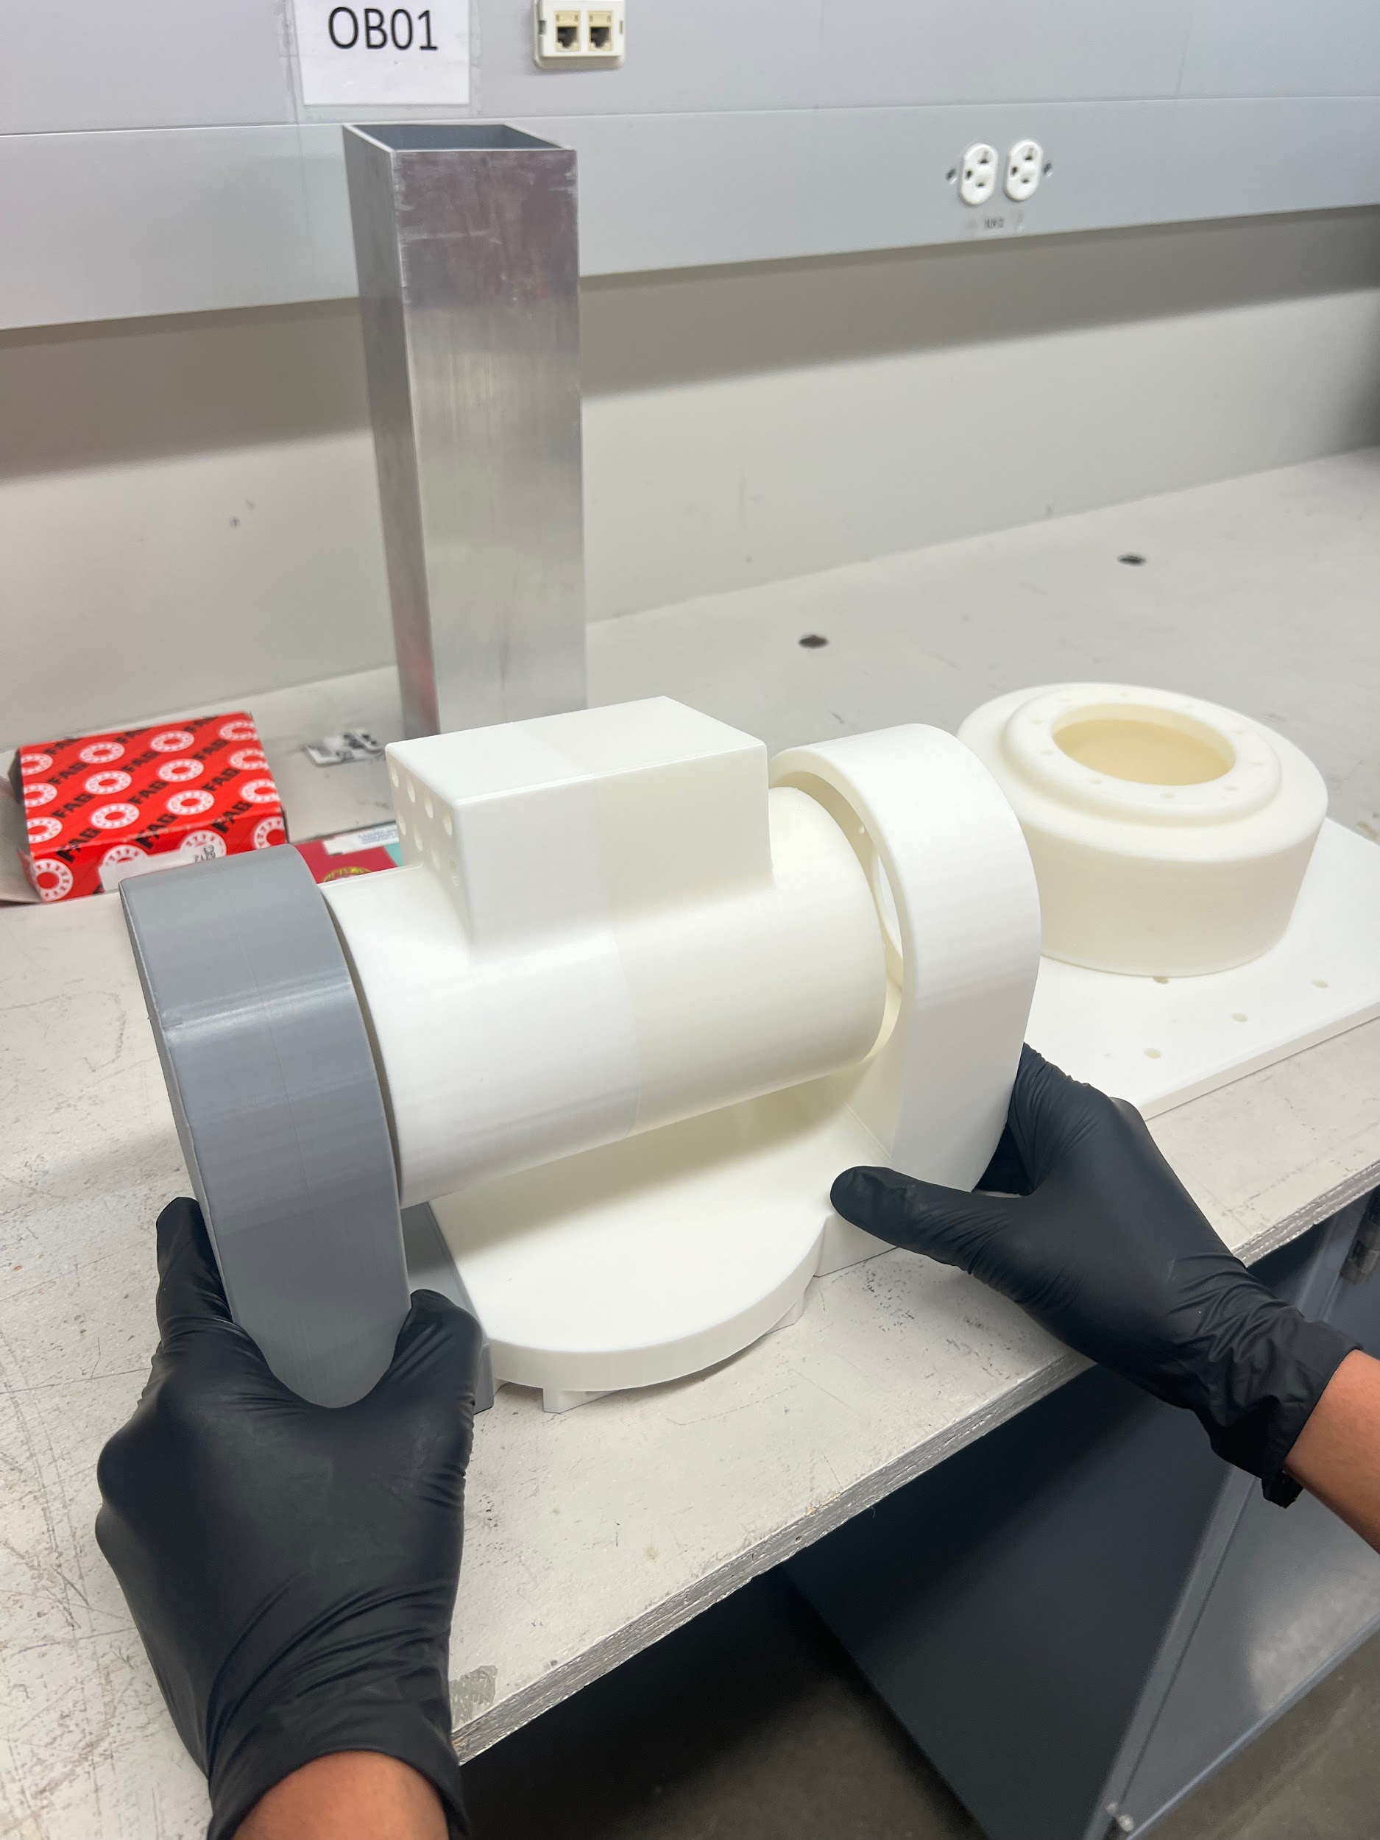
Prototyping Fabrication

Slide 8
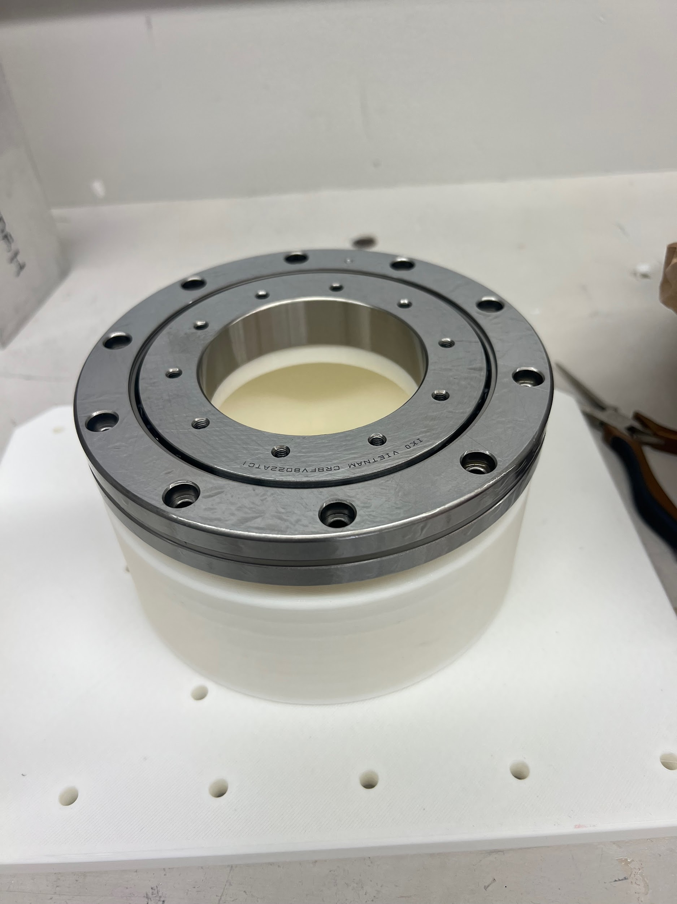
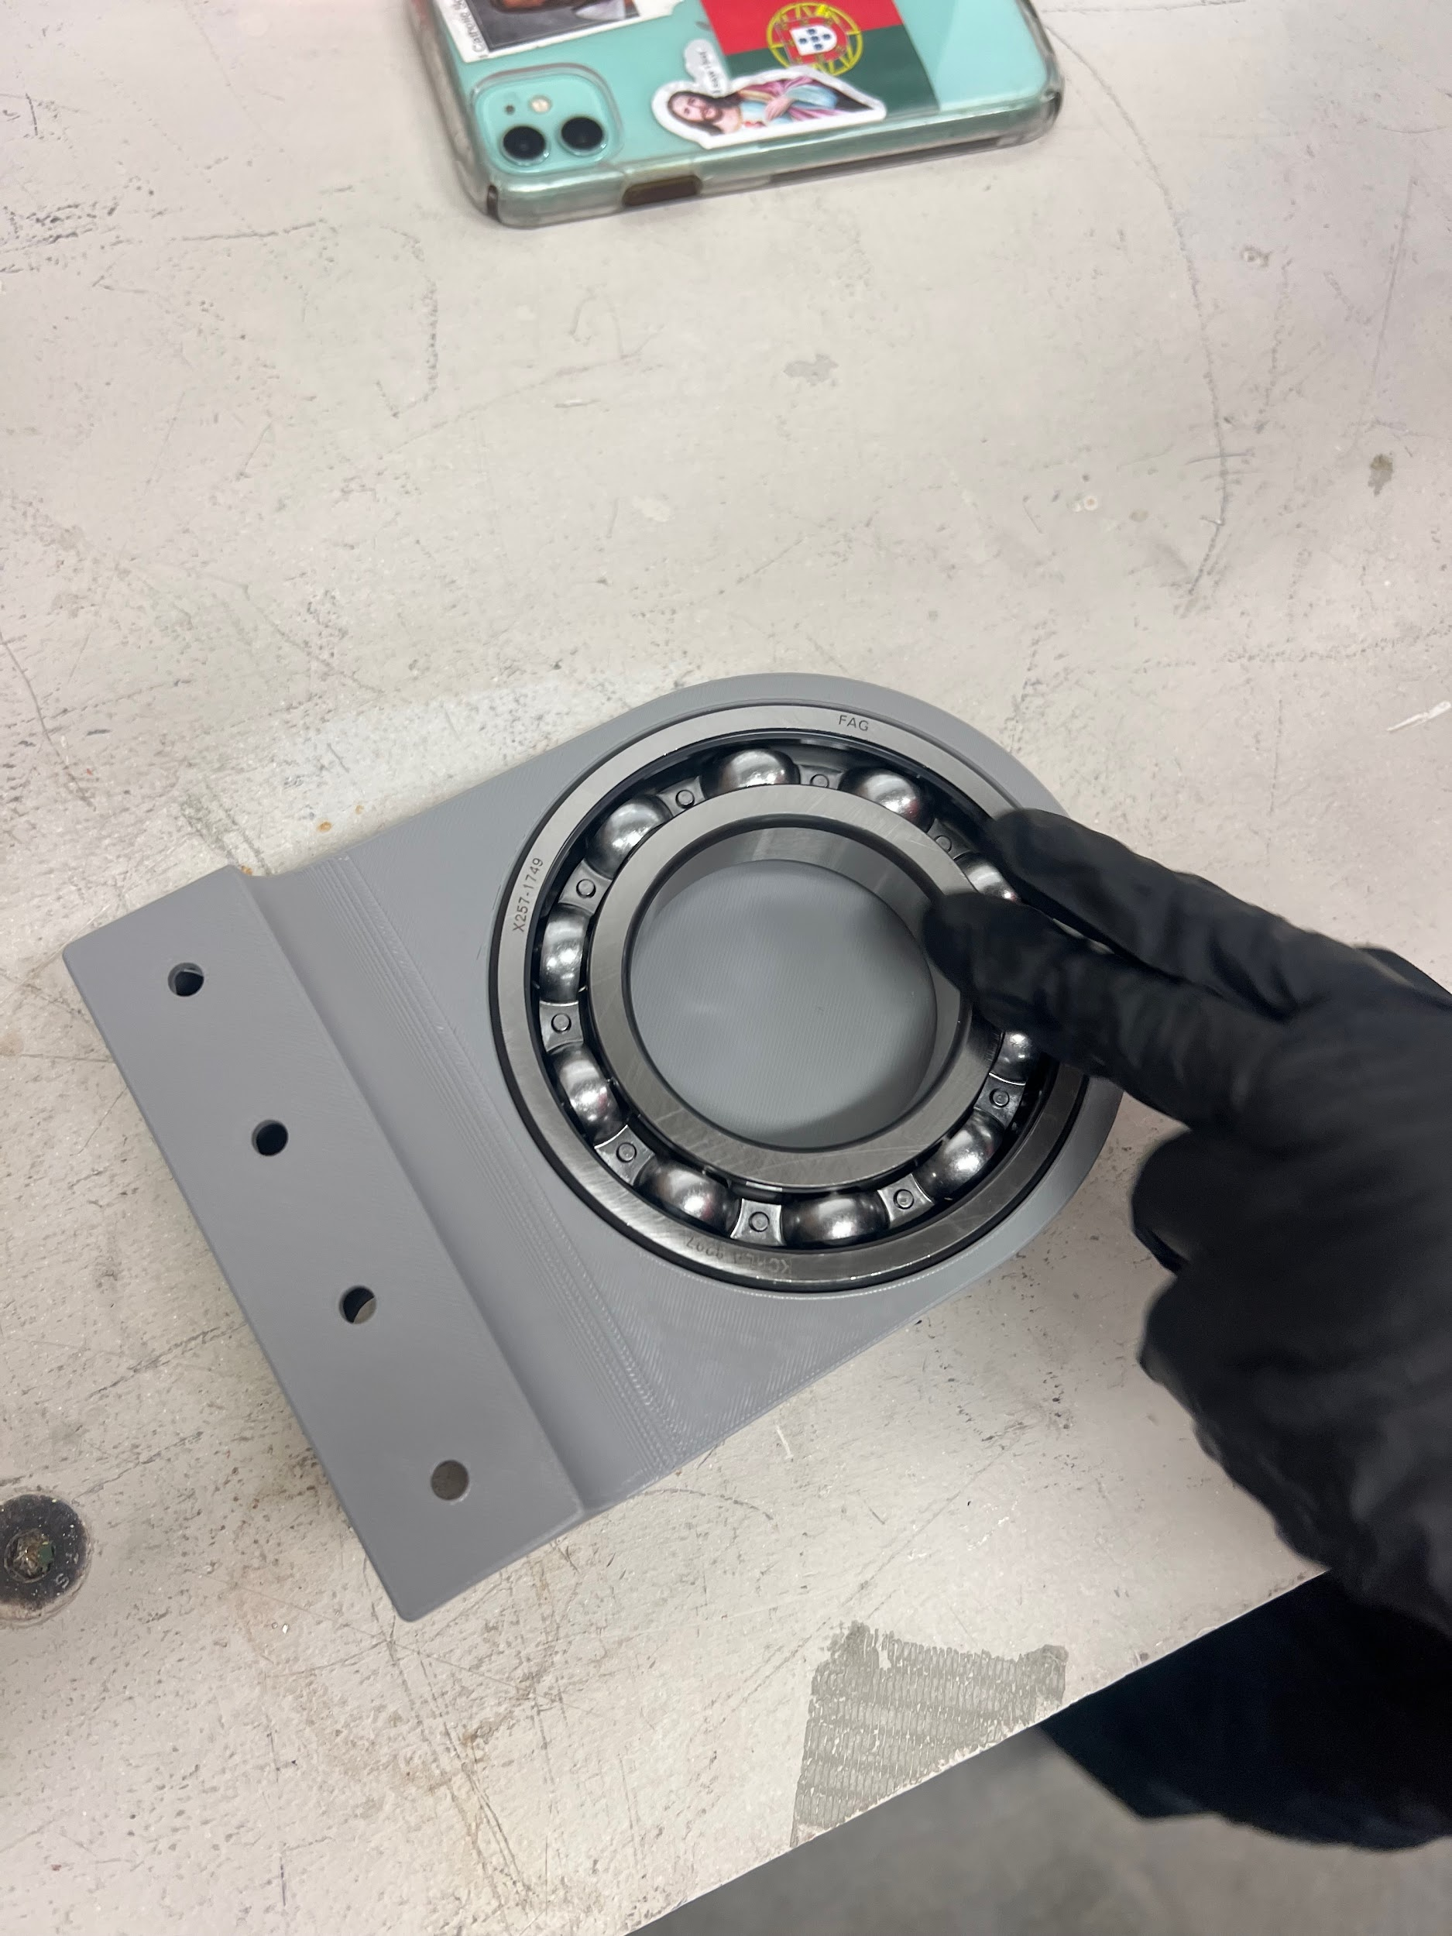
Prototyping Fabrication

Slide 9
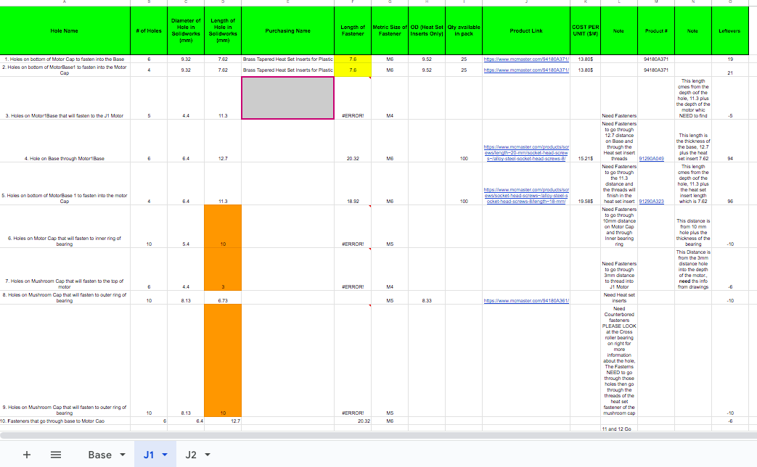
Fasteners
Partner with CAD team to finalize fastener selection
Ensure Assembly ready designs
Cost Reduction Initiatives
Refine CAD Parts to reduce fastener quantity
Optimize fastener choices for cost-effectiveness
Finished J1 and Base working through J2

Slide 10
Motor Research
Found playlist on controlling CubeMars motors specifically
“Upper computer software is needed”
Reached out to CubeMars to download software
2 different modes:
MIT mode: Controls one loop at a time
Servo mode: Controls torque and position

Slide 11
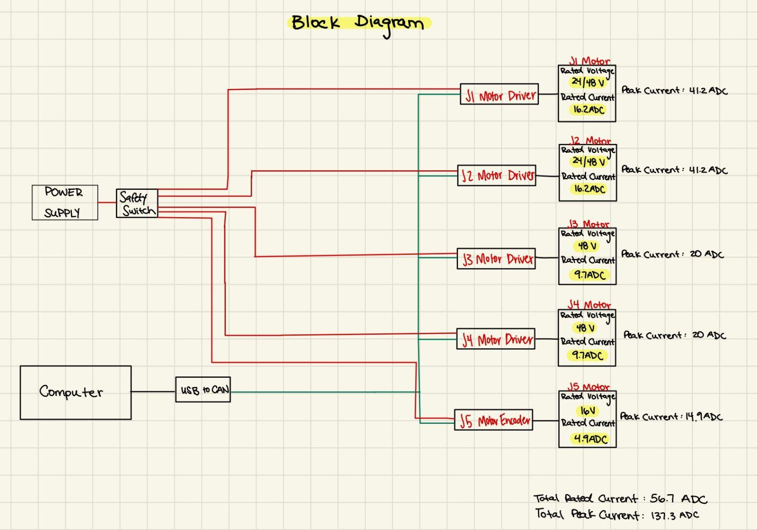
Electrical Block Diagram

Slide 12
Future Work
Continue refining CAD and prototyping
Continue Selection Process with Fasteners and Ordering
Order electrical components
Begin assembling Base, J1, and J2
Finish Project Success Agreement and receive approval
Capstone Showcase April 25th

